Slide 1

Ursinus Scavenger Hunt
Final Project: Human Computer Interaction
Done by;
Arthur Artene
Marcos Maciel
Henry Wilt
Alex Crocamo

Slide 2
Demo Time

Slide 3
Our Why

Slide 4

Stakeholders

Slide 5
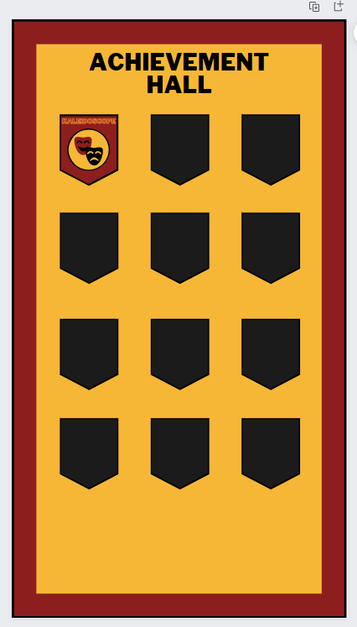
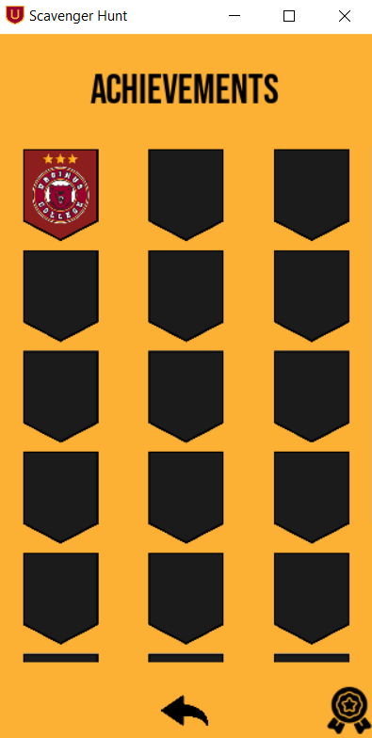









Achievements Page
Original Design
Achieved Design

Slide 6
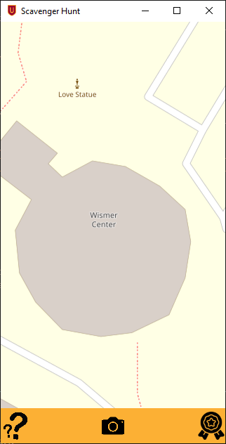
Our Findings
Markers need to be clearer
Locations (ie. Writing Fellows, Tutoring, etc.)
A start up page when first opening the app would be useful
Understanding of what the buttons do, before clicking on them

Slide 7

Any Questions

Slide 8
Thank you

